Slide 1


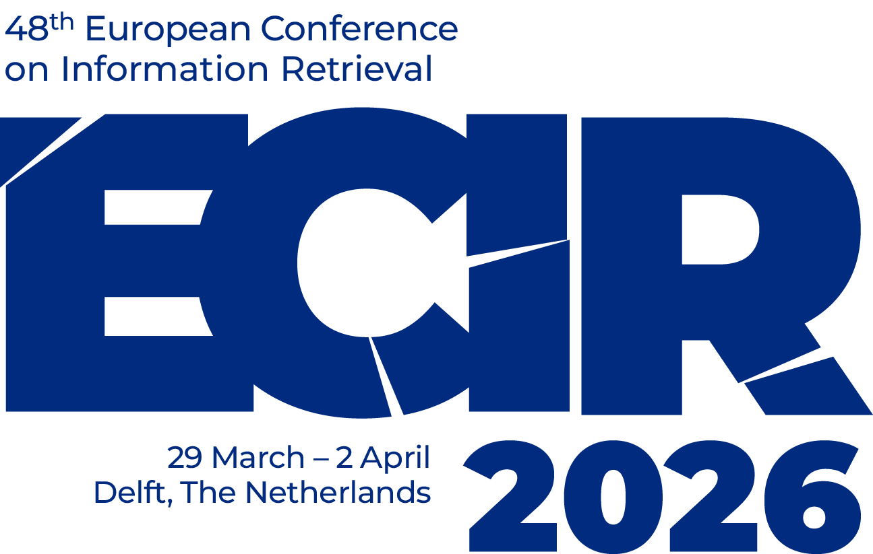
IR-for-Good Track

Slide 2
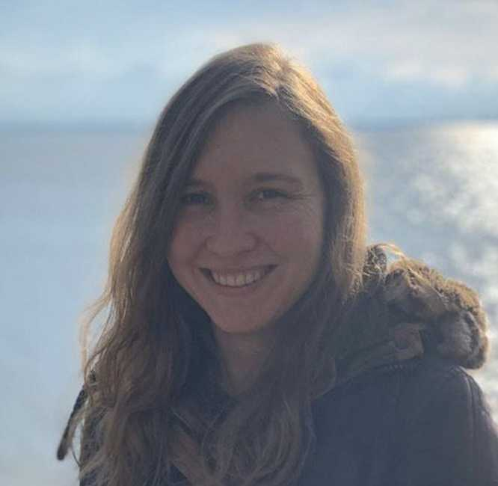
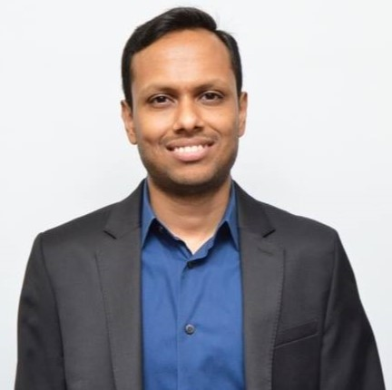
We are your Track Chairs
Maria Heuss
University of Amsterdam
The Netherlands
Bhaskar Mitra
Independent Researcher
Canada

Slide 3
This year’s theme for the track
What is IR-for-Good?

Slide 4
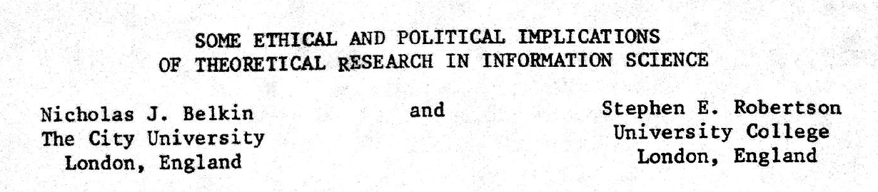
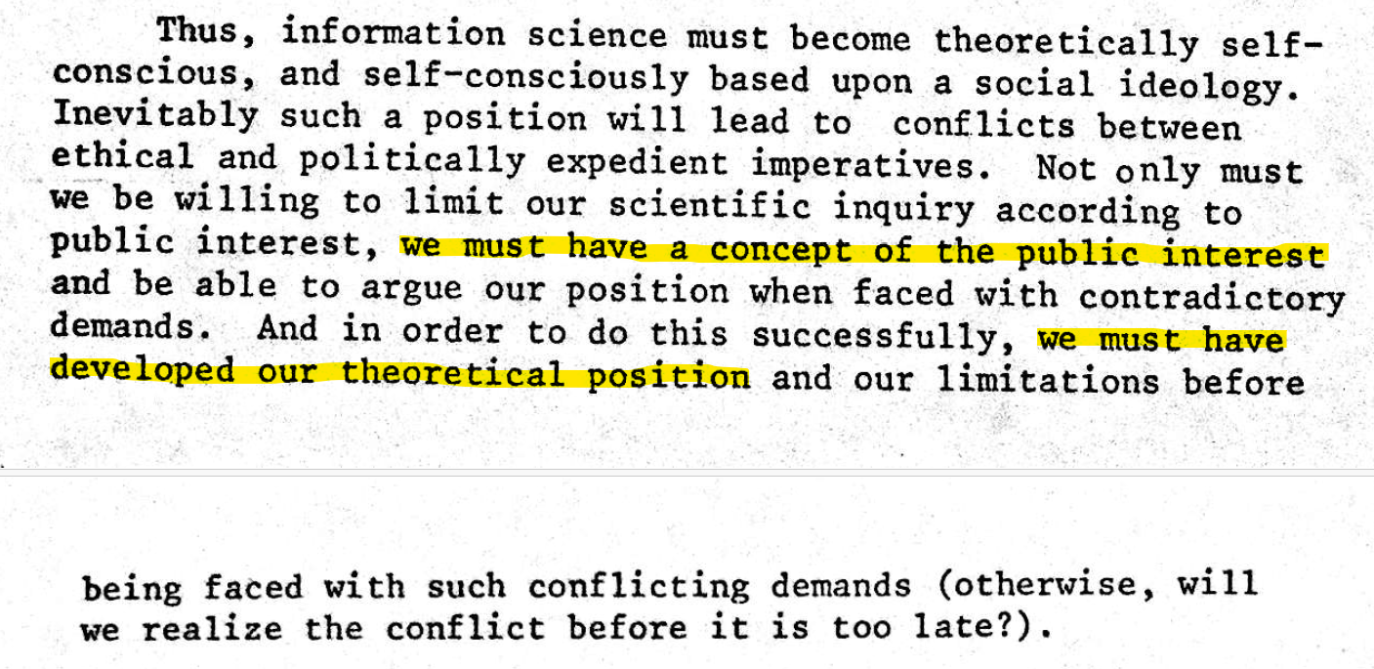
Published in 1976 (half a century ago)
Belkin and Robertson. Some Ethical and Political Implications of Theoretical Research in Information Science. In proc. ASIS, 1976.

Slide 5
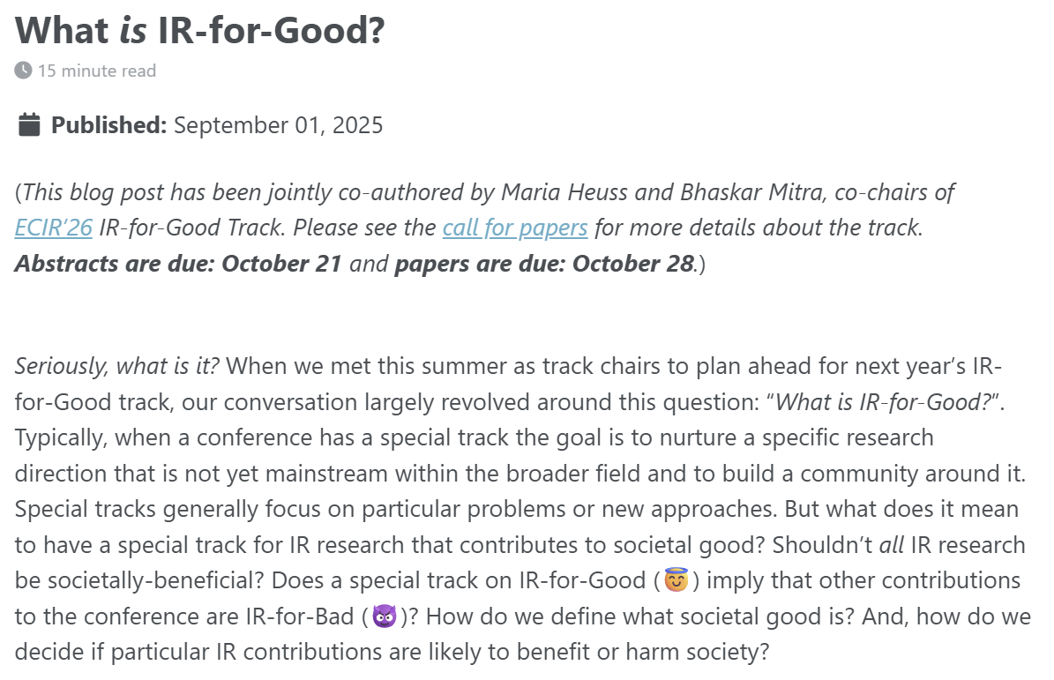
The topic of “IR-for-good” is currently undertheorized
As Belkin and Robertson (1976) point out, we must develop our position on what constitutes societal good to make appropriate progress and resist contradictory demands
Mitra and Heuss. What is IR-for-Good?. Blog post, 2025.

Slide 6
This year, we adopted the following operative definition for IR-for-Good
IR-for-Good refers to IR research and practices that contribute towards realizing more equitable, emancipatory, and sustainable futures.
https://ecir2026.eu/calls/call-for-ir-for-good-papers

Slide 7
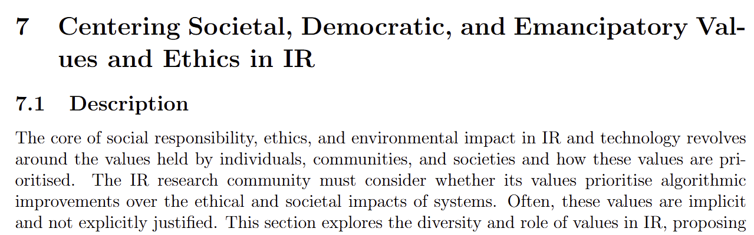
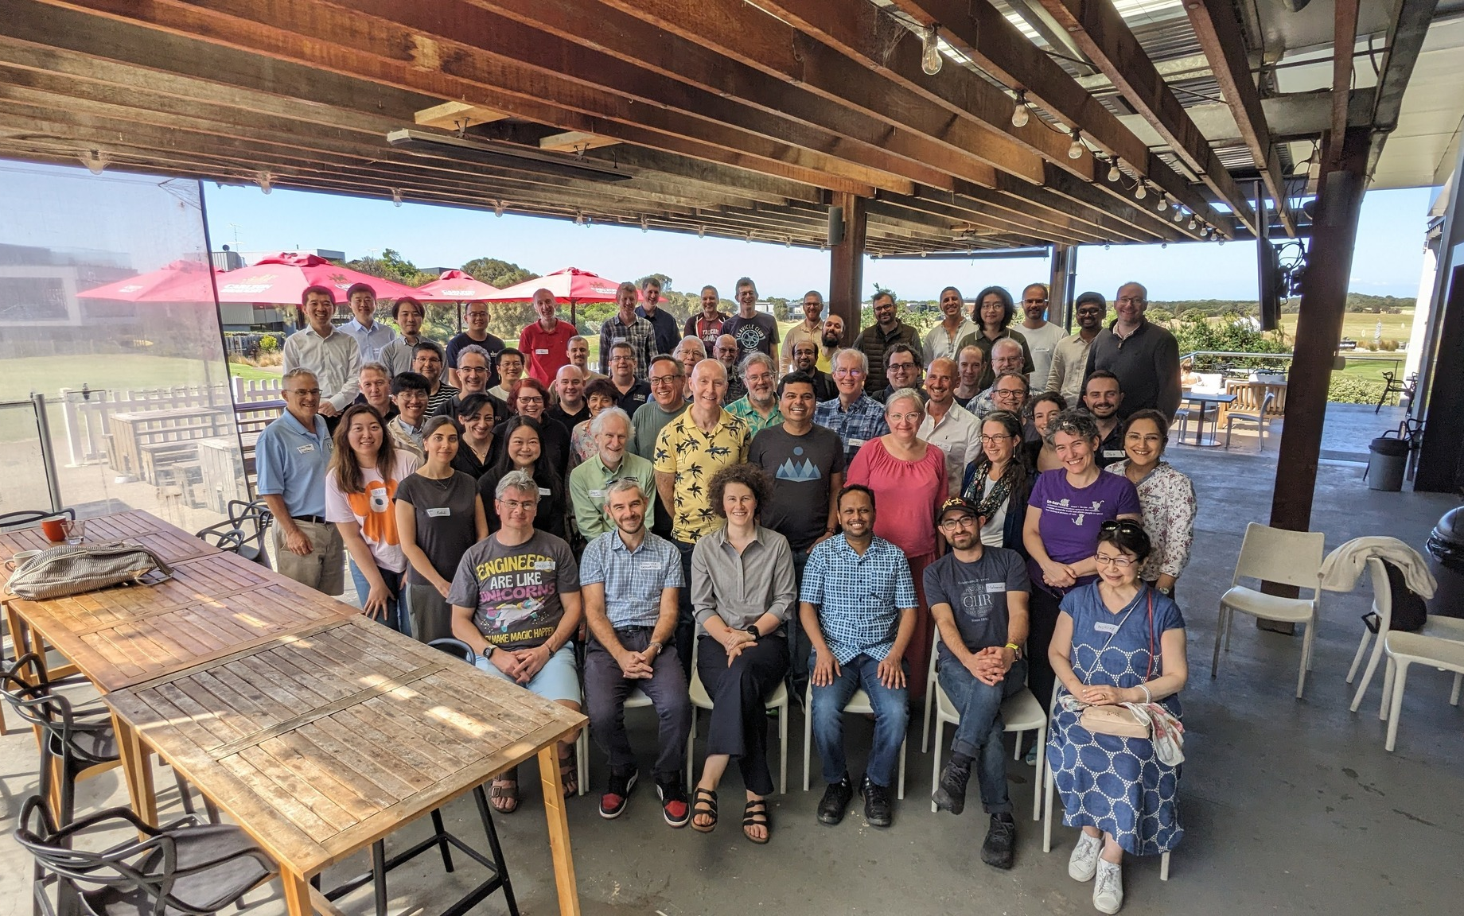
This year, we adopted the following operative definition for IR-for-Good
IR-for-Good refers to IR research and practices that contribute towards realizing more equitable, emancipatory, and sustainable futures.
We were motivated by calls to center desired societal outcomes in IR (e.g., at SWIRL’25)
The 4th Strategic Workshop on Information Retrieval in Lorne (SWIRL), 2025
https://ecir2026.eu/calls/call-for-ir-for-good-papers

Slide 8
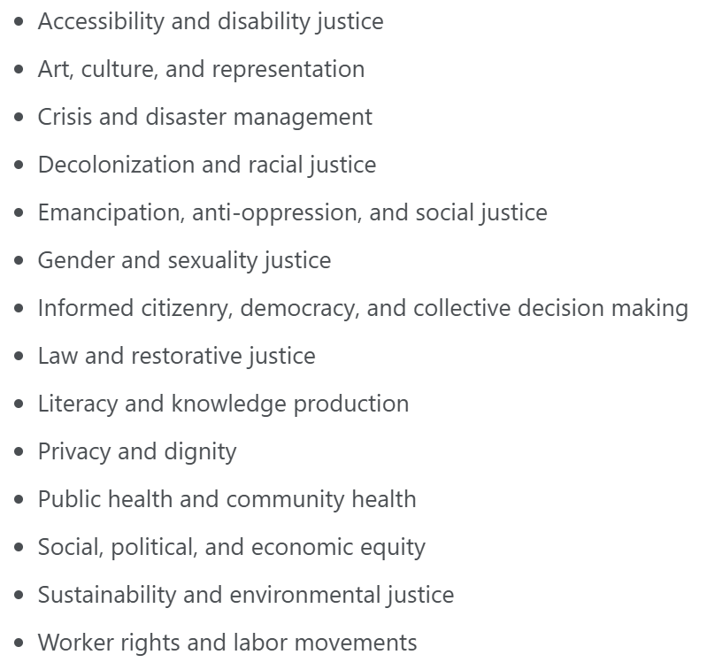
Topics of interest
How IR intersects with and/or can support:
Intentional choice to center topics on outcomes (e.g., equity, emancipation, justice, and sustainability) instead of on approaches (e.g., procedural fairness, interpretability, and transparency)
https://ecir2026.eu/calls/call-for-ir-for-good-papers

Slide 9
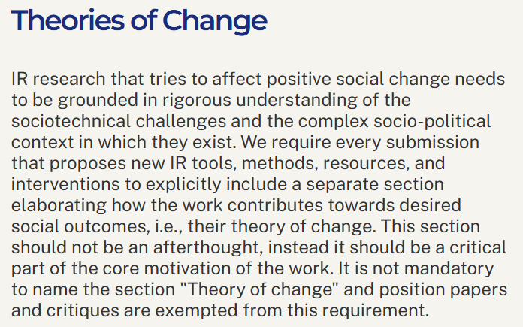
Towards a shared understanding
of IR-for-Good
This year, we encouraged authors to make explicit their goals and theories of change; which we hope allows community reflection, critical analysis, and further development of a community-wide shared understanding of what constitutes IR-for-Good
Definition. A theory of change is a method that explains how a given intervention, or set of interventions, is expected to lead to specific change
https://ecir2026.eu/calls/call-for-ir-for-good-papers

Slide 10
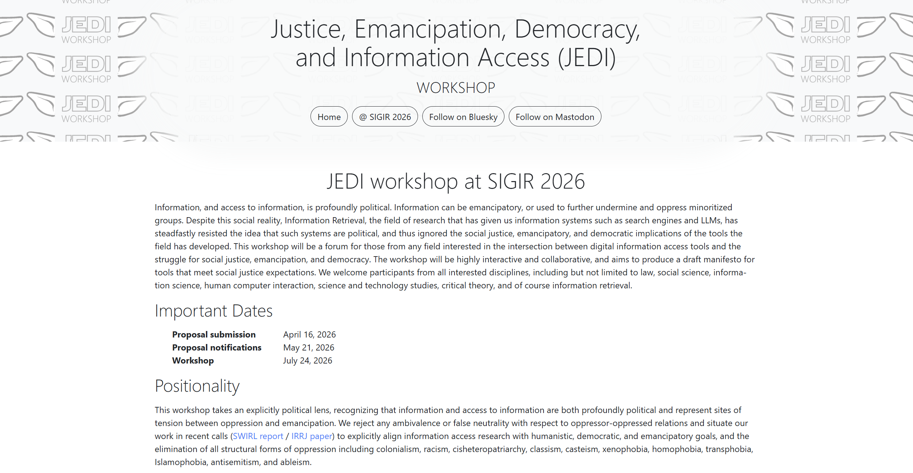

Check out our call-for-presentations and don’t forget to follow us on Bluesky and Mastodon
https://jedi.inertial.science/

Slide 11
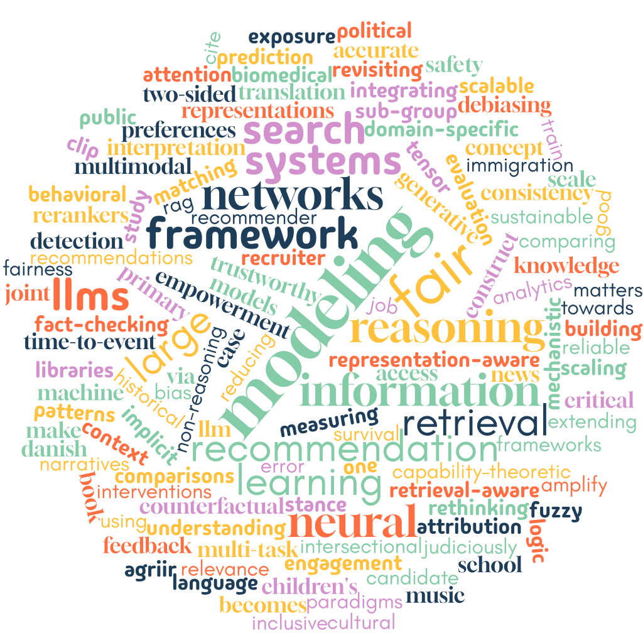
Accepted Papers
General Themes of Accepted Papers
Fairness & Bias in Ranking and Retrieval
Bias & Representation in Recommender Systems
Societal Impact & Narrative Construction
Trustworthy & Reliable LLMs for IR
Inclusive & Domain-Specific Access to Information
19/56 submitted papers were accepted
—> 34% acceptance rate

Slide 12
Track Agenda
Monday
10:30 - 12:30: IR-for-Good Paper Session I
13:30 - 14:30: IR-for-Good Paper Session II
16:00 - 17:15: IR-for-Good Invited Talks and Panel
16:00 - 16:15: Invited Talk by Dana Mckay on "Anything But Ordinary: How other disciplines
can help move beyond the average searcher"
16:15 - 16:30: Invited Talk by Djoerd Hiemstra on "OpenWebSearch.eu: Towards a shared
infrastructure for assembling web search engines”
16:30 - 17:15: Panel Discussion on "What is IR-for-Good?"
Panelists: Madeleine Daepp, Dana Mckay, Djoerd Hiemstra, Sanne Vrijenhoek,
and Bhaskar Mitra
Tuesday
09:00 - 10:00: IR-for-good Keynote by Madeleine Daepp on "Gemini Hegemony"
10:30 - 12:30: IR-for-Good Paper Session III

